Slide 1
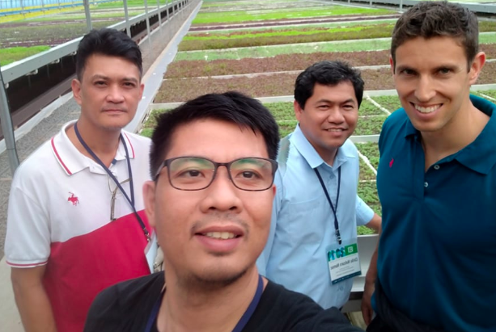
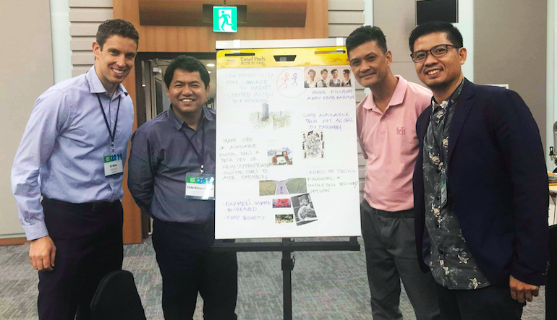
Team Philippines
World Bank
Eli Weiss
Philippines
Engr. Cirilo Namoc
Joseph Pacon
Jourvin Barrera
Knowledge Exchange on Digital Agriculture Technology
Workshop Output
Knowledge Exchange on Digital Agriculture Technology
Workshop Output

Slide 2
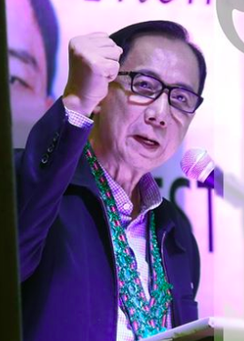
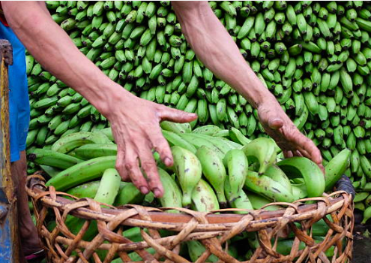
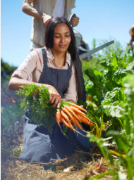
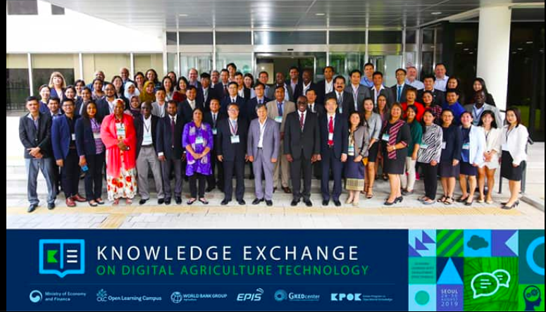
The Philippine’s Agenda
For The Filipino Farmers “Our Dream”
ANI
“Harvest”
KITA
“Income”
Key takeaways from the “Technical Knowledge Exchange” relevant to ANI and KITA
Dr. Willian Dar
Secretary, Department of Agriculture, Philippines

Slide 3
The Philippine’s Agenda
For The Filipino Farmers “Our Dream”
ANI
“Harvest”
KITA
“Income”
Young professionals into farming
DATs, help
craft lucrative smart farming
Importance of public-private
partnership
in the development and making the DATs work for farmers
Reduced cost of labor
Government’s support; Vital to DATs
Increase in productivity
Technologies and DATs available from other countries
Dr. Willian Dar
Secretary, Department of Agriculture, Philippines
Access to real-time needed information

Slide 4
“Low ANI”
“Harvest”
“Low KITA”
“Income”
The Key Challenges
Cropping adversely affected by climate change hazards
Inadequate inputs and others needed for production
Inadequate linkage with market
Many farmers (smallholders) lack know-how to mitigate effects of climate hazards
Many farmers lack of access to financing
Lack of coordination among value chain actors
Lack of awareness on some financing institutions (low interest rates)
Produce not in accordance with demand
Many farmers (smallholders) lack access to information on climate resilient farming methods & technologies
Banks have voluminous requirements for loans

Slide 5
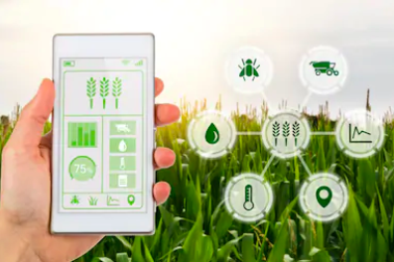
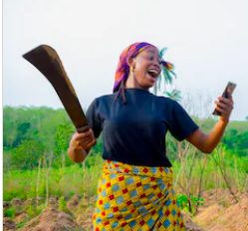
“Low ANI”
“Harvest”
“Low KITA”
“Income”
The Key Challenges
“Digital Tools”
The
Solution
Cropping adversely affected by climate change hazards
Inadequate inputs and others needed for production
Inadequate linkage with market
Lack of coordination among value chain actors
Many farmers lack of access to financing
Lack of coordination among value chain actors
Many farmers (smallholders) lack know-how to mitigate effects of climate hazards
Many farmers lack of access to financing
Lack of awareness on some financing institutions (low interest rates)
Produce not in accordance with demand
Produce not in accordance with demand
Many farmers (smallholders) lack access to information on climate resilient farming methods & technologies
Many farmers (smallholders) lack access to information on climate resilient farming methods & technologies
Banks have voluminous requirements for loans

Slide 6
The Key Challenges
Access to available information (advisories)/ techniques/ methods) and technology
Local & International
Access to information on private & govt. organizations / groups providing financial assistance to farmers / fishers (affordable rates)
Expedite communication between traders / buyers and farmers on the demand (quantity, quality and schedule)
“Digital Tools”
The
Solution
Many farmers (smallholders) lack access to information on climate resilient farming methods & technologies
Many farmers lack of access to financing
Lack of coordination among value chain actors
Produce not in accordance with demand

Slide 7
Action Plan
Our Way Forward

Slide 8
Key Challenges (Concerns) | Short-term Plan (1-3 Years) | Medium-term Plan (3-5 Years) | Long-term Plan (5-10 Years)
Lack of access of farmers to information on climate resilient farming methods & technologies (reducing production) | Inventory of existing / available DATs that are appropriate for Filipino farmers (local & international)—smart farming, expediting access to financing & access to market related tools Gap analysis: Demand VS DATs available DATs available but not accessed Development of DATs (gap between demand and available tools) Building capacity of the farmers to access and use DATs (smart farming, access to financing and linking with markets) through training, others Piloting of DAT supported Green House Facility (WB or Govt. funding) Programs to motivate youth / young professionals to venture into farming (IEC, training, etc.) | Enhancement / Expansion of the DATs based on feedback / lessons Rollout of the enhanced / Expanded DATs E-learning modules for smart farming Website for DATs in the Philippines (how to use tools, sharing of success stories, etc.) Promotion of establishment of DAT supported GH facility (GOP) with other producers Continues programs for motivating youth in farming | Creation of a dedicated operating units in the Department of Agriculture (e.g., division / office) that will manage the continues enhancement of DATs, tapping of emerging local & international DATs to be accessed by the farmers, training of farmers on use of tools / technologies, monitoring of use of DATs, others.
Lack of access to financing
Limited linkage with market due to Lack of coordination among value chain actors and Produce not in accordance with demand

Slide 9
Opportunities and Barriers
Opportunities:
Digital Agricultural Tools (DATs) introduced in this Knowledge Exchange
Other DATs available both within and outside of the country that are not yet accessed by the farmers and fishers
Agriculture sector earning high support from the current administration pushing for the agenda of “Food Security”
Barriers:
Ageing farmers might be hesitant to use digital tools and technologies

Slide 10
Concrete technical / investment financing
support needed
Buy-in- from the President of the Philippines to support DAT’s application in the country (including budget and human resources needed)
Cooperation from other national government agencies and private sector apart from Agriculture Department (DA) on the rollout of DATs (DA not the sole player towards ANI and KITA)
Government to allocate annual budgets making the country’s agriculture aided with digital technologies.

Slide 11
Thank You!

